Slide 1


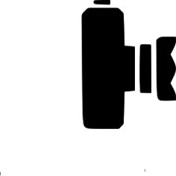
MLiS-2 AUTONOMOUS
DDCAR
DRIVING CAR
Dalila Michelle Islas Sanchez
Divyansh Oze
01

Slide 2
01
02
03
Introduction
Dataset
Approaches
TABLE OF CONTENTS
04
05
06
Discussion
Conclusion
References
Importance and motivations
Data pre-processing
Types of Models
How would we do the project if we had to do it again
02
Notes:
We have organized this talk in the following way:
Importance and motivations,
Some data observations ,
The type of approaches that we follow
How would we do the project if we had to do it again,
And finally our conclusions and references

Slide 3
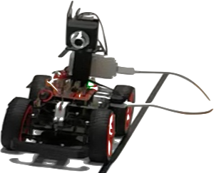
01
INTRODUCTION
03

Slide 4

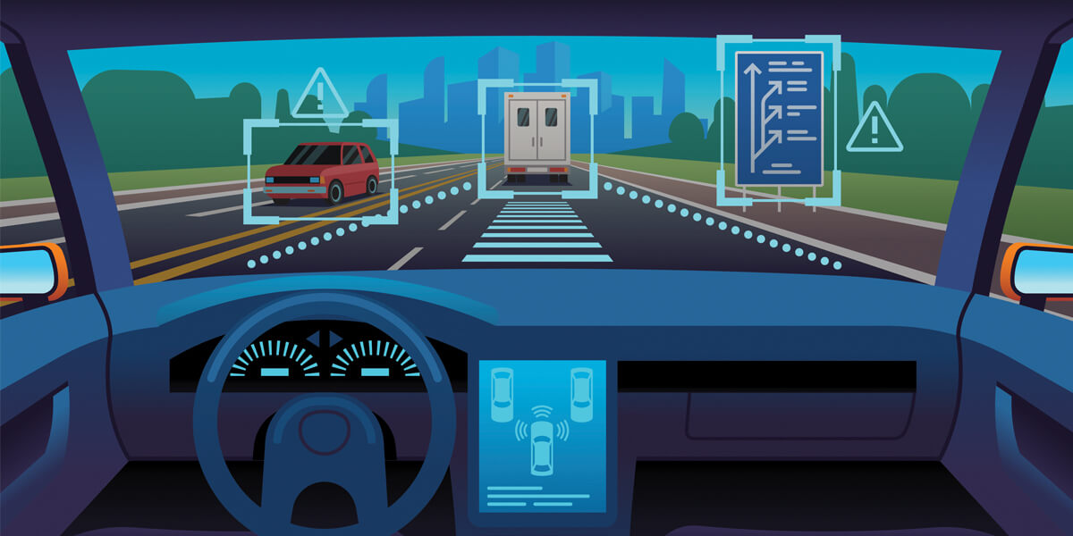
DEEP LEARNING
Why CNN or Deep Learning for Autonomous Car?
04

Slide 5
Autonomous driving:
Before
Now
Ernst Dickmanns
Vision saccadic, probabilistic, computation, and parallel programming.
Tesla
Autopilot, CNN, RNN, LSTM, GAN, etc.
05
https://arxiv.org/pdf/2006.06091.pdf
Notes:
We will now introduce the state of the art of autonomous drive quickly:
-Ernst Dickmanns is considered a pioneer of the first modern autonomous car. He used advanced technology that combined saccadic vision (a rapid movement of the eye, head or other body parts of animals or devices) with probabilistic calculations and parallel computing.
-Today we can say that numerous brands and technology companies are working on the development of the autonomous car. Tesla is one of the main precursors today of this type of system 'Autopilot’. Also CNN, LSTM, which will be discussed in the last sections.

Slide 6
02
DATASET
06

Slide 7

DATA
Testing Images
1020
14,820
files
13.8 k
Training Images
Containing images of track, with objects on and off the track.
Training norm .csv file
No labels for the Testing Images
07

Slide 8
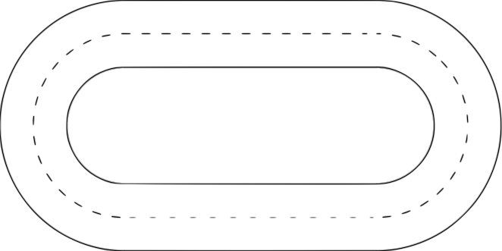
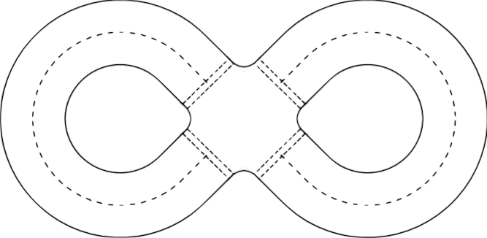
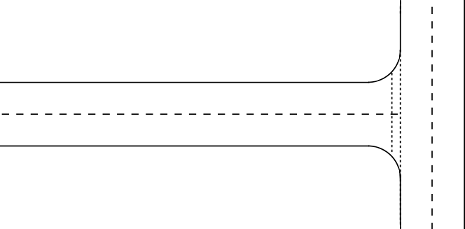
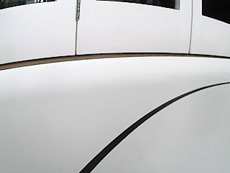
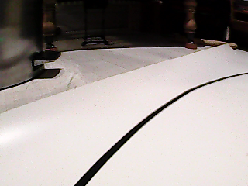
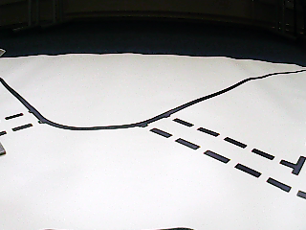
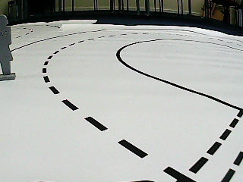
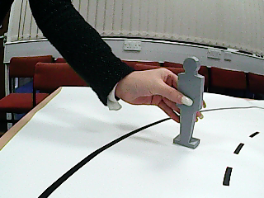
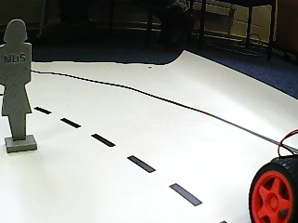
DATA OBSERVATION
Oval track scenarios
Eight-Track scenarios
Special scenarios
08
Notes:
-The training data was recorded on 3 tracks: The Oval Track, Figure-of-Eight Track and the T-junction track.
The general observation being that the oval track was the most common driving scenario as compared to the others, which were uncommon.
Adding on to the observations:
There were fewer of this type of image, where the camera only detected a line, which made the car not know what to do in the live test.
Many images of this type were also missing from the training, affecting the live test as well.
-We also noticed some special scenario where there were external objects interfering with the obstacles on the track. A few examples of such are shown on the screen:
[1. Arm holding the ‘person’ object kept on the track.]
[2. Also, 6 empty images were found in the training data (that we marked as corrupt files in our code]

Slide 9
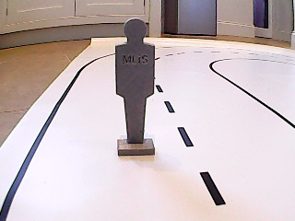
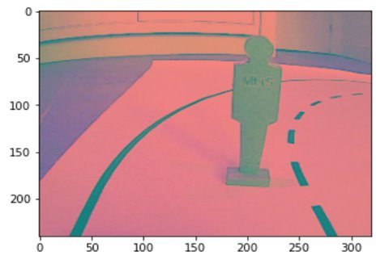
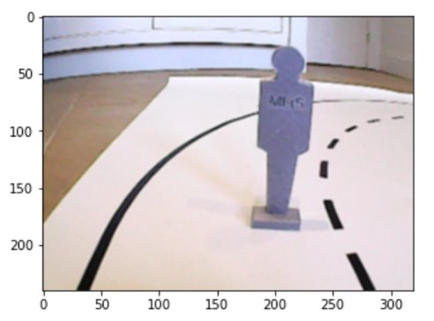
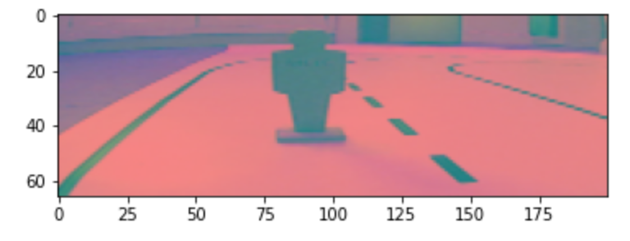
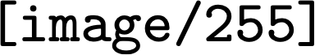
IMAGE PRE-PROCESSING
Original Image
RGB2YUV​
Gaussian Blur ​
Resizing Normalizing ​
The Original Image
(300x240 resolution)
9

Slide 10
03
APPROACHES
010

Slide 11

MODELS
Supervised Rule-Base Learning
End-to-End Learning
Transfer Learning
List of models approached during the project:
Nvidia Model
Inception-ResNet-v2
+
Nvidia Model
Object Detection Model
11
Notes:
We tried to make use of three diffferent models, one was an end-to-end model where we made use of nvidia, second being the transfer learning model where we loaded Inception-ResNet-V2 from tensorflow and Nvidia model to tune in the last few layers to get our desired outputs, third being the supervised rule-based model which used labels for each object and rules dedicated to each object for speed and special scenarios.

Slide 12
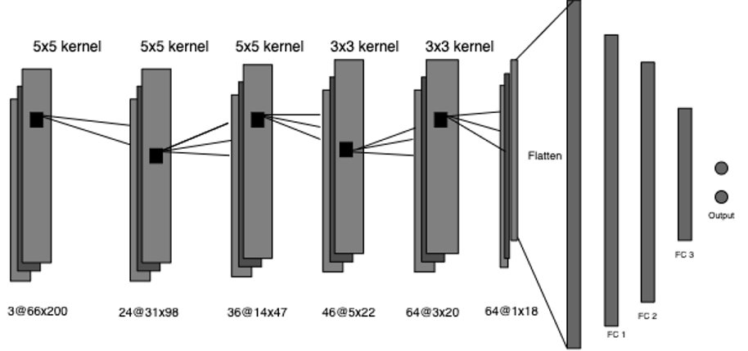
End-to-End-Learning
Architecture:
5 Convolutional Layers
3 Dense layers
2 Output Nodes
NVIDIA MODEL
Scores on Kaggle with the Nvidia model:
Public Score: 0.03972
Private Score: 0.03279
012
Notes:
let's speak about the end-to-end-learning
The network has about 27 million connections and 250 thousand parameters.
-The network consists of 8 layers, 5 convolutional layers and 3 fully connected layers and 2 outputs. The input image is split into YUV planes and passed to the network.
-The convolutional layers were designed to perform feature extraction. We use a 5×5 kernel in the first three convolutional layers
and a 3×3 kernel size in the last two convolutional layers.
In the nvidia The fully connected layers are designed to function as a controller for steering
[Mention the score at the end]
-This end-to-end approach proved surprisingly powerful

Slide 13
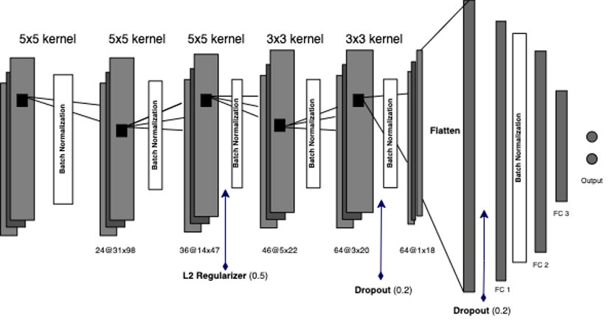
Hyper-Parameter Tuning on the Nvidia Model
BatchNormalization() : Between Conv and Dense layers.
Impact on error rates
Dropouts() : Dropout of 0.2.
Change in errors
Regularizers (L2): 2x[L2] at Conv layers and 1x[L2] at dense layer.
Dip error and Kaggle score
Learning Rate: 0.001
New Kaggle Score with Hyper-Parameter Tuned Nvidia Model:
Public Score: 0.0294
Private Score: 0.0334
13

Slide 14
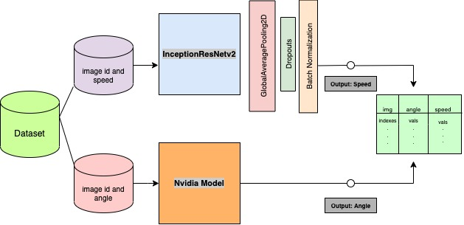
Transfer Learning
Architecture:
InceptionNet: Predict Speed
Nvidia Model: Predict Angle
INCEPTION –RESNET-V2
Kaggle Scores for the model shown above:
Public Score: 0.0724
Private Score: 0.0771
014
Notes:
For this we used a base neutral networks, (which are CNNs that extract features from an image, from low-level features, such as persons, traffic light, or a stop sign, etc).
-GoogLeNet architecture is also known as Inception Model. Consists of 22 layer in deep. It reduces the number of parameters from 60 million (AlexNet) to 4 million.
The data is loaded in the same way we did with Nvidia. Only that now the pre-processing we’ll be a bit different, we’re going to change the image size because it needs to be square.
and the input is defined (the top layer that was removed). Here the weights are loaded from where the weights were obtained, frozen. This is a complex CNN network
then these 3 layers are passed(global average, dropouts,batchn), and finally we have the dense layers that is the output speed.
-InceptionNet : predict speed
complex CNN network
GlobalAveragePooling: instead of classical CNN fully connected layers (to generate a feature map of each category)
Dropouts, BN
- -Nvidia Model was used to predict angle
Outputs: Angle and Speed
[this was the basis for the attempted object detection model]

Slide 15
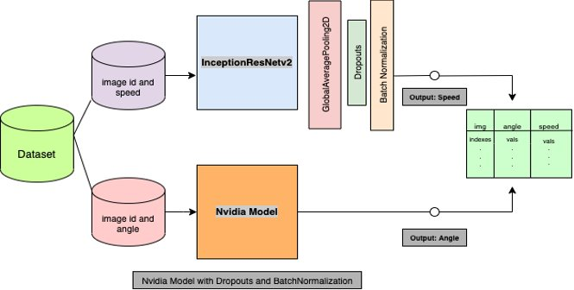
Hyper-Parameter Tuning on the Inception Model
BatchNormalization() : Applied ahead of the InceptionNet
Dip in error observed
Dropouts() : Dropout of 0.2 ahead of InceptionNet.
Small difference in error rate
GlobalPooling2D: Applied post InceptionNet
Small difference noted on error
Learning Rate: 0.001
Took a long time to train
15
Kaggle Scores for the Hyper-Parameter tuned model shown above:​ Public Score: 0.0701 Private Score: 0.0720

Slide 16
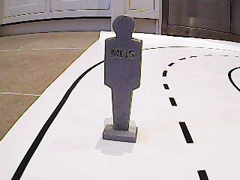
Supervised/Rule-Base Learning
Person
Speed
INPUT
OBJECT DETECTION
OBJECT DETECTION
Right Arrow
Angle
Red Light
. . .
. . .
TF record file
Person, 100%
Red Light, 75%
016
Notes:
-the idea of this approach that unfortunately, we could not implement was:
-as an input we need this is the image and a tfrecord consisting of a "table" with image i'ds, classes, location of the bounding boxes, we do this through the xml annotation files.
[to have the training data classified and structured]
--then we choose a model from the model zoo (Tensorflow) , “ssd_mobilenet_v2_keras” (that uses the 2nd version of MobileNet to extract features, SSD to detect objects, and pre-trained on the COCO dataset) to do object detection.
-to finally result in different types of classes (with some probability), and based on that certain rules are generated for each specific object and case.
(If you are working with large datasets, using a binary file format for storage of your data can have a significant impact on the performance of your import pipeline and as a consequence on the training time of your model).]

Slide 17
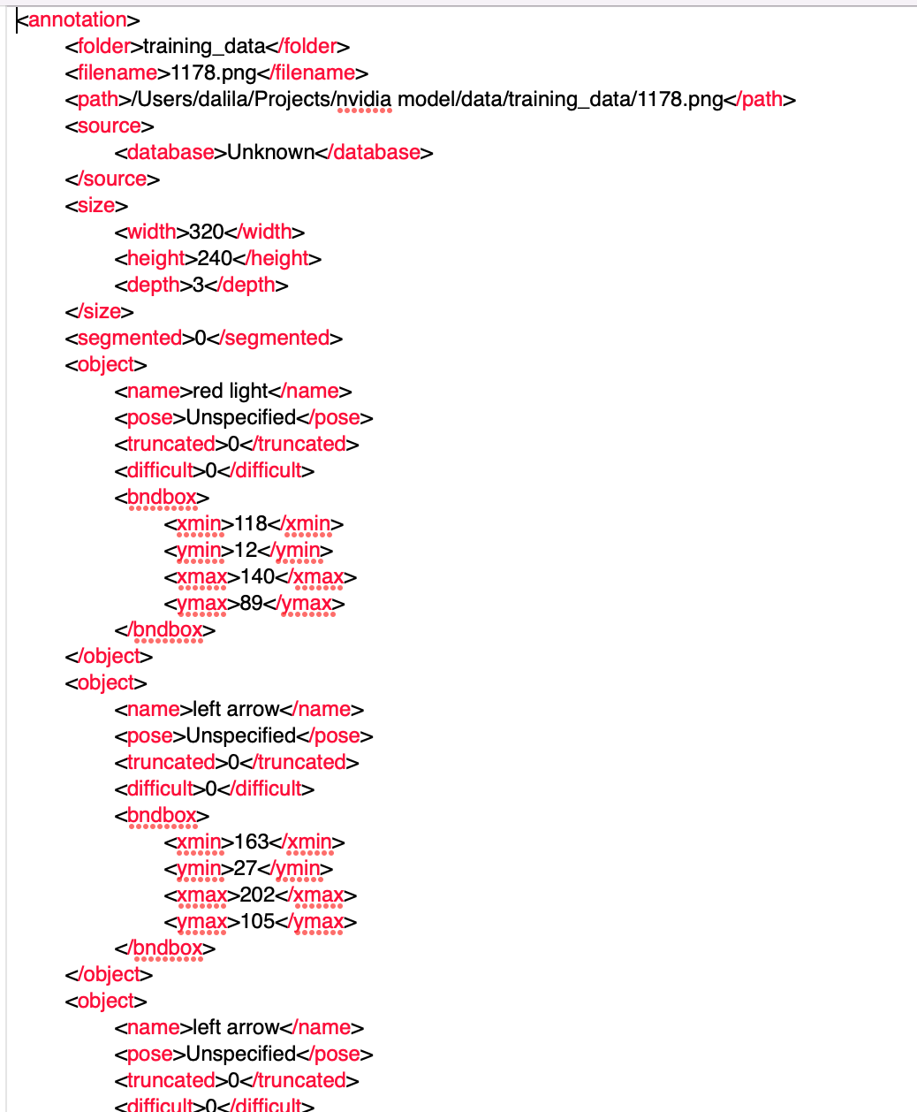
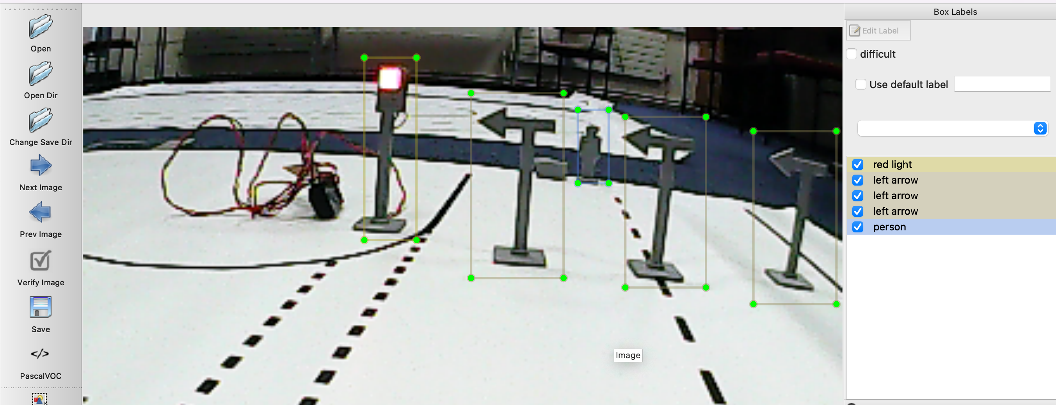
OBSERVATIONS
LabelImg
Mars
712 manually labelled images
17
Labelled images
XML files

Slide 18
04
DISCUSSION
018

Slide 19
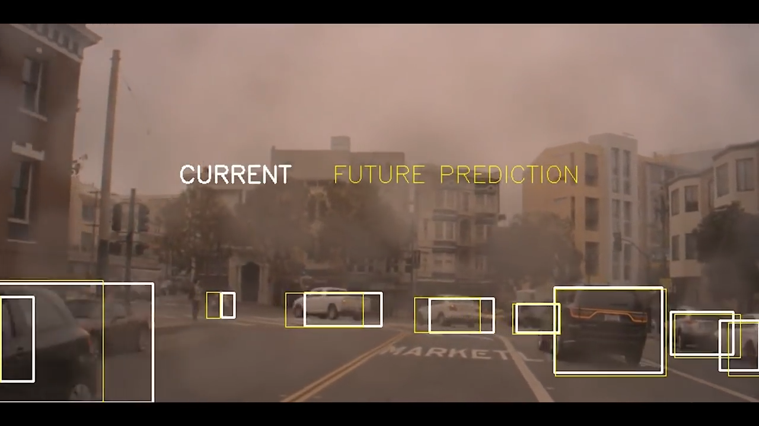
RELATED WORK & FUTURE PROSPECTS
Nvidia Drive Labs, RNNs:
State-of-the-art technique on temporal data​
​
Use of Radar and Lidar sensors to predict Object Velocity​
​
RNN outputs:
Time-to-Collision,
Future Position
Future Velocity
for each object
https://www.youtube.com/watch?v=OT_MxopvfQ0
19

Slide 20
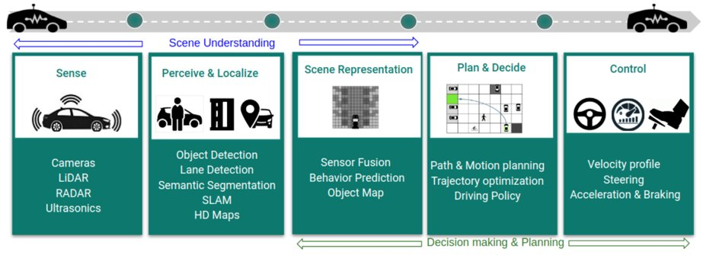
RELATED WORK & FUTURE PROSPECTS
RL for Autonomous Driving:
Scene understanding with Lidars ​
Perception and Environment Mapping for States​
Planning and Driving Policy​
Controller for outputs
Scene Understanding
Sense
Perceive & Localise
Scene Representation
Plan & Decide
Control
Cameras
LiDAR
RADAR
Ultrasonics
Object Detection
Lane Detection
Semantic Segmentation
SLAM
HD Maps
Sensor Fusion
Behavior Prediction
Object Map
Path & Motion planning
Trajectory optimisation
Driving Policy
Velocity profile
Steering
Acceleration & Braking
Decision making & Planning
https://arxiv.org/pdf/2002.00444.pdf
20
Notes:
- Another good approach to solve this problem is using RL, where an agent learns by exploring and interacting with the environment. In this case, the self-driving car is an agent.
Here you can see the Standard components in a modern autonomous driving systems pipeline:
1.) Use of camera’s and radars like LIDARs for absolute localisation.
2.) Perception module to give 2d representation (bird-eye) of the environment
[Uncertainties here propagate to rest of info, robust sensing-> safety and right policy] [semantic segmentation, motion and depth estimation etc]
-The states in env would contain lane positions, drivable zones, location of agents etc with objects and others.
3.) Motion-level commands and planning
[6 Degrees of freedom, holonomic; traditional algos like A* fail on non-holonomic case for autonomous driving] [they ignore dynamics and differential constraints] 4.) Outputs from Controller:
-Speed,Steering Angle, Braking actions over every point for a map.
[Holonomic: when controllable degrees of freedom are equal to the total degrees of freedom]
[Non-holonomic- car; DOF limited. Holonomic- Robot; 6 DOF]
[Car: it has only two controls, but its configuration space has dimension 3]
[Ego Vehicle- vehicle that contains sensors and perceives the env]

Slide 21
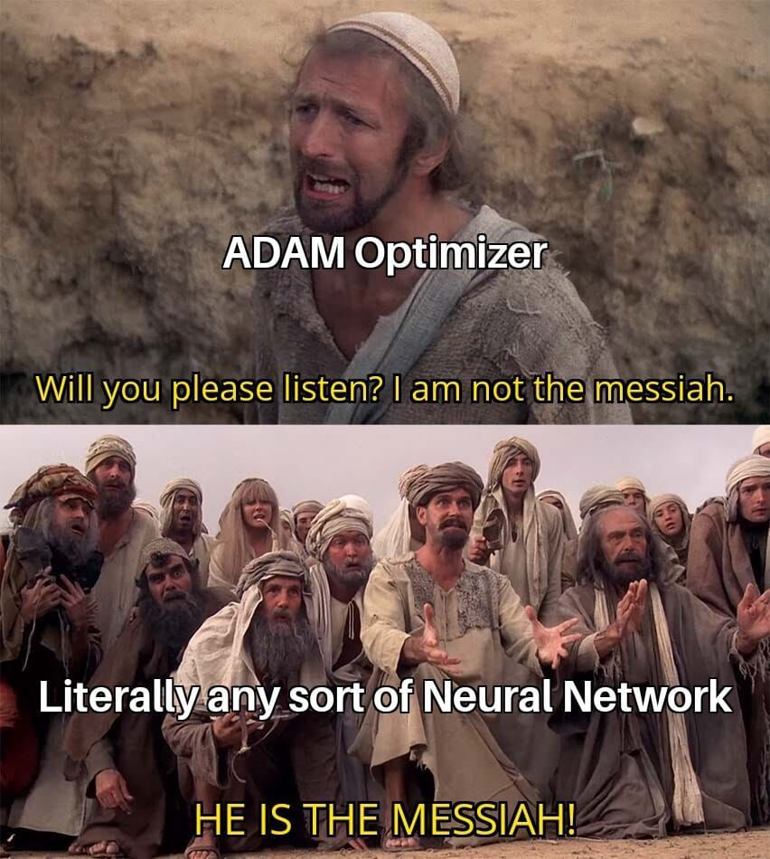
05
CONCLUSION
021

Slide 22
PROS & CONS
Nvidia Model
Basic CNN architecture
Low accuracy results
Low inference time,
Less complexity
Highest Kaggle score
High error on Kaggle
Training Time
Transfer Learning Model
Using InceptionNet: Much deeper network
ImageNet Database
Object Detection Model
Manually label
High inference time
Labelled Images,
Rules for specific scenarios
22

Slide 23
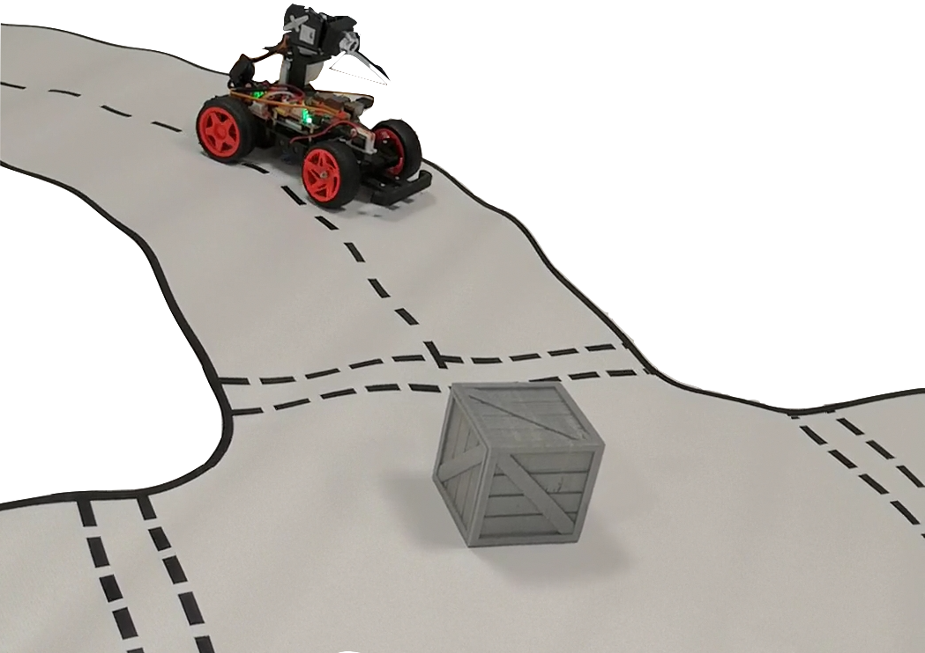
REFERENCES
Autonomous Lane Navigation, David Tian, DeePiCar Series, 2019, [https://towardsdatascience.com/deeppicar-part-5-lane-following-via-deep-learning-d93acdce6110]
Autonomous car using CNN deep learning algorithm, Sonata et al. , Journal of Physics, 2021, DOI: 10.1088/1742-6596/1869/1/012071
End to End Learning for Self-Driving Cars [arXiv:1604.07316v1 [cs.CV] 25 Apr 2016]
Weighted Random Search for CNN Hyperparameter Optimization, Razvan et al. , International Journal of Computers Communications & Control, 2020, DOI: 10.48550/arXiv.2003.13300
Deep Reinforcement Learning for Autonomous Driving: A Survey B Ravi Kiran1 , Ibrahim Sobh2 , Victor Talpaert3 , Patrick Mannion4; [https://arxiv.org/pdf/2002.00444.pdf]
DRIVE Labs: Predicting the Future with RNNs [https://blogs.nvidia.com/blog/2019/05/22/drive-labs-predicting-future-motion]

